Slide 1



Inventory & Spend Analysis ABC Company
Michael Murphy

Slide 2



Introduction
Scope: Embarking on a comprehensive analytical journey for ABC company's liquor store network, encompassing 80 stores with a diverse stock of 6,600 brands.
Data: Navigating through 1 million sales records over two months and 2 million purchasing entries across a year.
Strategic Aim: Crafting a robust analytical framework designed to decode complex inventory patterns and spending behaviors, setting the stage for strategic resource allocation and financial optimization.
Impact: Enabling informed decision-making that aligns with operational excellence and market dynamics, steering ABC company toward a data-driven future.

Slide 3


Executive Summary
Inventory Insights: Delivers real-time visibility into stock levels of 6,600 brands across 80 stores, optimizing inventory turnover and reducing shortages or overstock scenarios.
Financial Clarity: Analyzes over 3 million records to track spending trends, providing a granular view of financial performance and highlighting cost-saving opportunities.
Actionable Intelligence: Empowers ABC company with a decision-making tool, offering clear directives for inventory and budget adjustments that respond to market demands.
Strategic Advancement: Positions ABC company at the forefront of data-driven operations, significantly enhancing its strategic planning and operational agility in the competitive liquor market landscape.

Slide 4
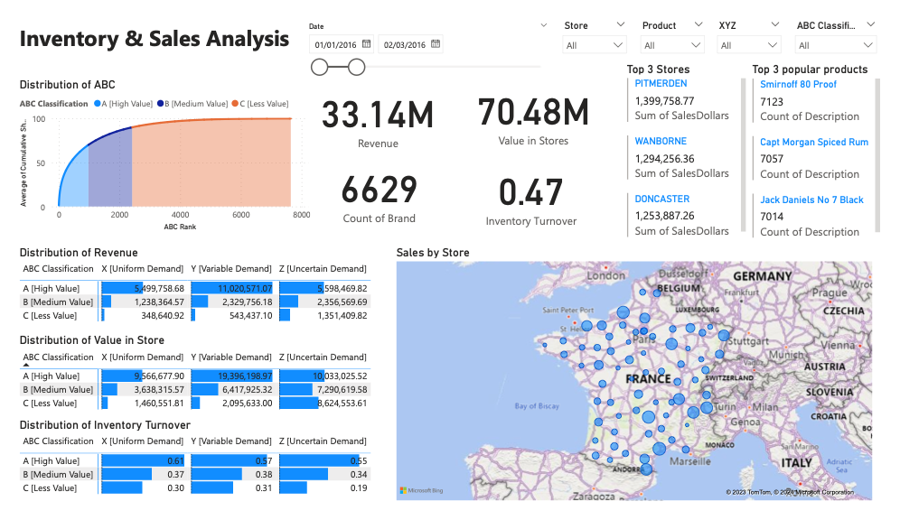
Inventory & Sales Analysis
The dashboard page serves as a strategic cockpit for visualizing and analyzing key metrics in inventory management and sales performance. It is designed to:
Provide a snapshot of the revenue generated, the value stored in inventory, and the efficiency of inventory turnover.
Display the distribution of products according to the ABC classification method, allowing quick assessment of inventory worth.
Offer insights into sales distribution across various store locations, spotlighting areas of high performance or potential concern.
Present top-selling products and stores, highlighting success stories and identifying best practices that can be replicated across the network.
This dashboard empowers stakeholders with the knowledge to make informed decisions on inventory control, financial planning, and operational strategy.

Slide 5
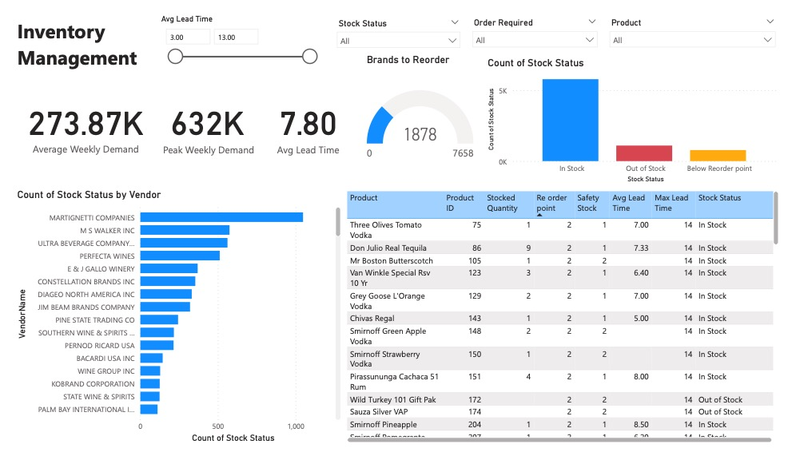
Inventory Management
The "Inventory Management” page is engineered to equip ABC company's decision-makers with real-time intelligence on stock levels and vendor contributions. Key features include:
Monitoring average weekly demand and peak demand to predict and prepare for inventory needs.
Tracking average lead times to ensure timely restocking, avoiding potential stockouts or excess inventory.
Visualizing stock status by vendor, which aids in assessing vendor reliability and their impact on inventory levels.
Detailing products that are in stock, out of stock, or below the reorder point, which is crucial for maintaining optimal inventory levels and ensuring product availability.
This page serves as an essential tool for proactive inventory management and strategic planning.

Slide 6
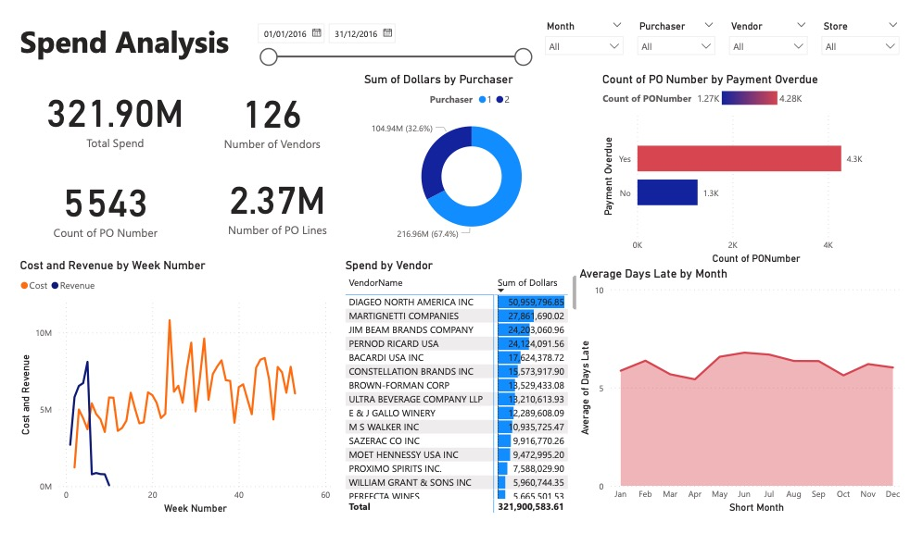
Spend Analysis
The "Spend Analysis" page is designed to provide ABC company with a comprehensive overview of its spending patterns. The dashboard highlights:
Total Spend: Showcasing the aggregate expenditure across the company.
Vendor Analysis: Detailing spend by vendor to monitor and manage supplier relationships.
PO Management: Tracking the count of purchase orders and lines, offering insights into procurement activity.
Payment Practices: Monitoring the payment overdue status, ensuring financial obligations are met promptly.
Temporal Spend Trends: Examining cost and revenue over time to identify seasonal trends and anomalies.
This dashboard is instrumental in optimizing cost management and enhancing the efficiency of the procurement process.

Slide 7
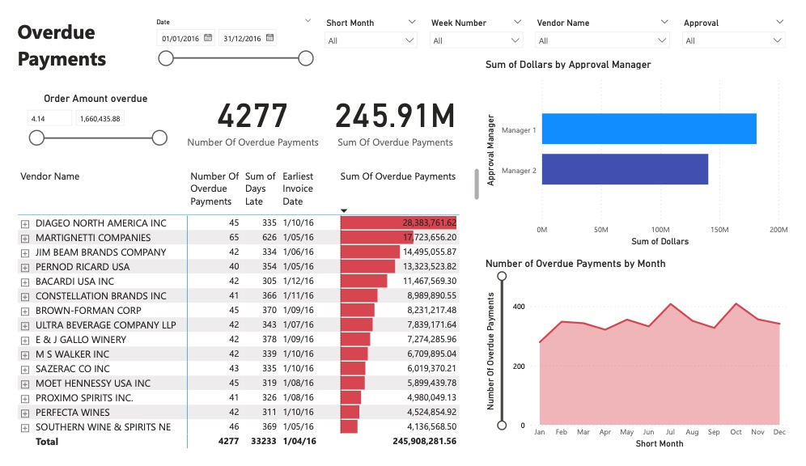
Overdue Payments
The "Overdue Payments" dashboard page is a critical tool for monitoring and managing financial obligations in the ABC company. It provides:
A comprehensive view of the total order amount overdue, enabling a quick assessment of the financial impact due to delayed payments.
An analysis of overdue payments, both in terms of the number of payments and the aggregate overdue amount, which is essential for financial risk assessment.
Insight into vendor payment practices, highlighting which vendors are consistently paid late, which could be indicative of process inefficiencies or disputes.
A breakdown of overdue payments by approval manager, which can help in evaluating the performance and decision-making impact of managerial roles.
A temporal view of overdue payments by month, assisting in identifying any seasonal patterns or trends in payment practices.
This dashboard empowers financial teams to take timely action to rectify payment issues, negotiate better terms, and improve cash flow management.

Slide 8
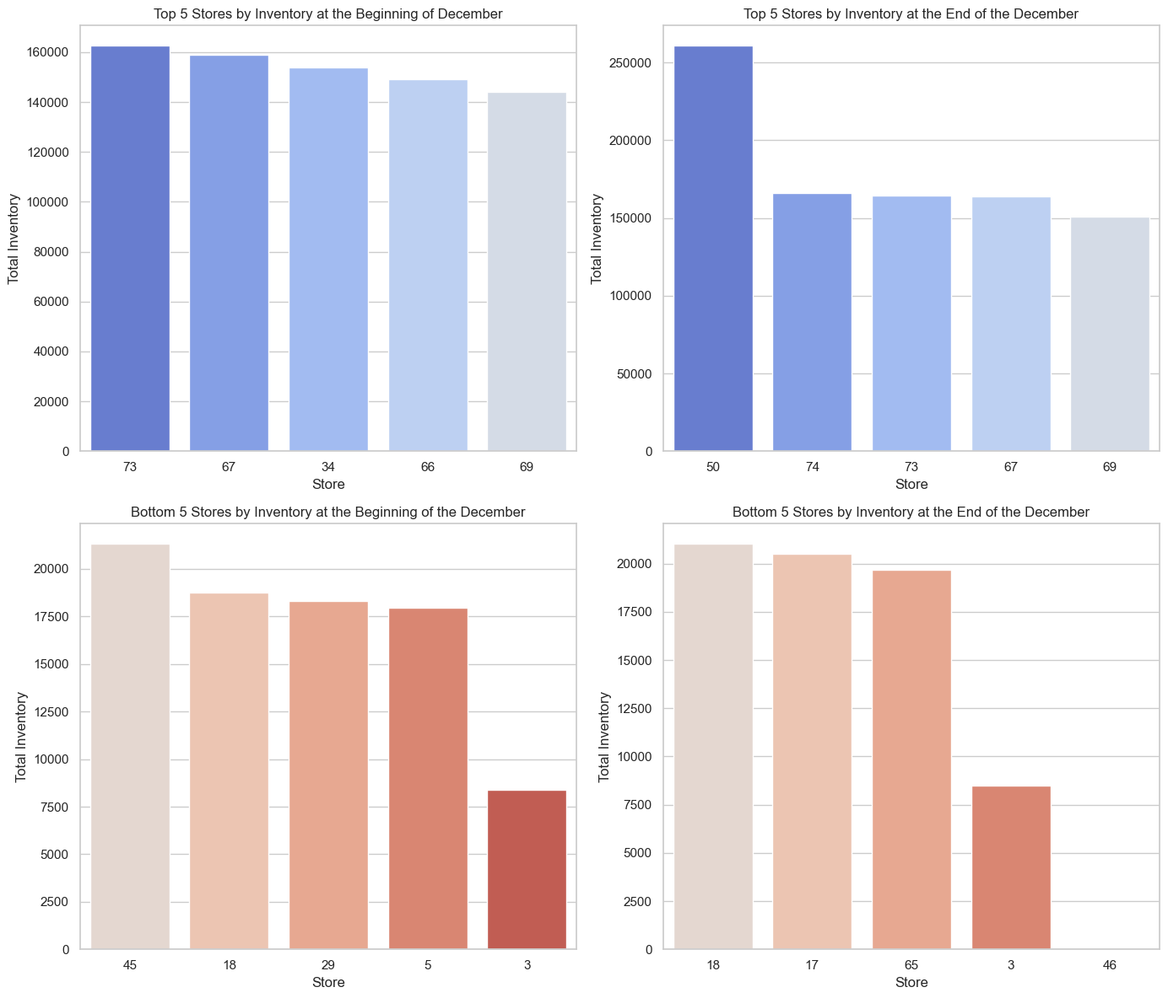
Store Inventory Insights
Strategic Shifts and Demand Response: Store 50's significant inventory increase to 260,717 highlights a strategic adjustment, possibly to meet surging demand or expand product offerings, showcasing the importance of agility in inventory management.
Consistency Among Leaders: Stores 73, 67, and 69 maintained top positions due to effective inventory management, indicating stable consumer demand and the success of their replenishment strategies.
Challenges at the Bottom: Store 3's persistent low inventory and Store 46's drop to zero inventory underscore the need for urgent review of stock replenishment and supply chain efficiency to prevent sales loss and customer dissatisfaction.
Dynamic Adjustments and Improvement Opportunities: The dynamic inventory adjustments of top stores in response to market trends contrast with bottom stores' need for strategic reviews, suggesting a balance is crucial between meeting demand and avoiding overstocking, with tailored strategies for low performers to boost their inventory and sales performance.

Slide 9
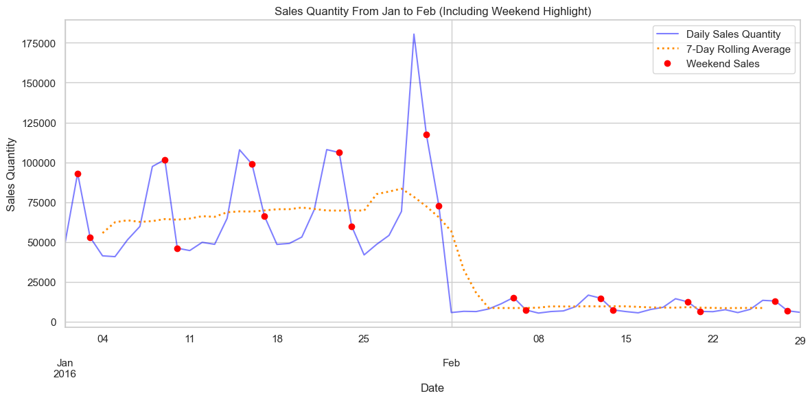
Sales Insights
Weekend Sales Surge: Sales data reveals peaks during weekends, suggesting increased customer activity and the need for strategic inventory and staffing adjustments to meet heightened demand.
Volatility and Influencing Factors: Daily sales exhibit significant volatility, with fluctuations potentially driven by promotional events, stock availability, or specific days, highlighting the importance of adaptive sales strategies.
Anomalies and Seasonal Trends: A significant sales spike in January and a subsequent decline towards February's end suggest the impact of special events or promotions and the necessity to understand these patterns for inventory planning.
Operational Adjustments: The discrepancy between the 7-day rolling average and actual sales, especially on weekends, underscores the need for real-time sales tracking and flexible inventory management to optimize stock levels and staffing.

Slide 10
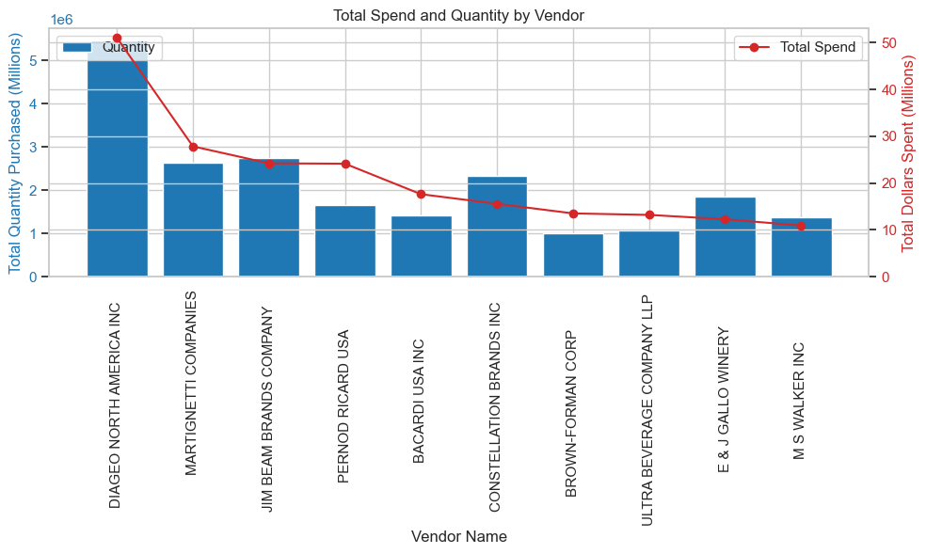
Spend Insights
1. Leading Supplier: DIAGEO NORTH AMERICA INC dominates as the top vendor by both quantity (5.46M units) and spend ($3.92M), highlighting its significant role in the supply chain.
2. Purchasing Trend: A direct correlation exists between the quantity purchased and total spend, showcasing a general trend where increased volume leads to higher expenditure.
3. Price Insights: ULTRA BEVERAGE COMPANY LLP, despite purchasing fewer units than MARTIGNETTI COMPANIES and CONSTELLATION BRANDS INC, spends more, suggesting its products have a higher average price.
4. Value Analysis: BROWN-FORMAN CORP and M S WALKER INC display an inverse relationship between quantity and spend, indicating potential differences in product pricing or the procurement of higher-value items.

Slide 11
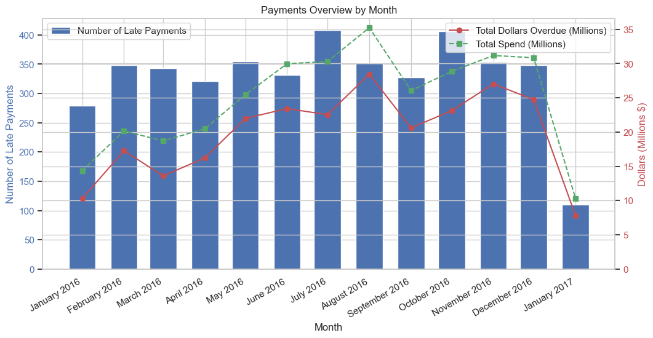
Overdue Payments Insights
Seasonal Late Payment Trends: Peaks in late payments during mid-year (June and July) and end-year (November) suggest a link to the company's business cycles or seasonal financial activities.
Spend vs. Overdue Payments Discrepancy: While spending peaks mid-year, overdue payments don't necessarily increase proportionally, highlighting effective payment management or varied terms for larger deals.
Year-End Payment Dynamics: A notable decrease in both spending and overdue payments in December and January may reflect year-end financial closures, budget constraints, or a slowdown in activities, with a concerted effort to settle debts before year's end.
Note: Overdue payments are calculated as payments past 30 days (Net 30)

Slide 12

Conclusion
In the analysis of ABC Company's inventory and spend, I have uncovered significant insights that pave the way for optimized operations and financial health. These findings spotlight the need for strategic adjustments to enhance efficiency and profitability.
Recommendations include:
Enhance Forecasting Accuracy: Implement advanced data analytics to improve inventory demand forecasting.
Streamline Procurement Processes: Adopt streamlined procurement methods to reduce costs and improve vendor relationships.
Optimize Inventory Levels: Adjust inventory levels to match demand, reducing excess and shortages.
Improve Payment Practices: Address overdue payments to enhance financial stability and vendor relations.
These steps are essential for ABC Company to strengthen its market position and drive sustainable growth.

Slide 13
Appendix - Data Model - All Tables
The comprehensive data model utilized in the Power BI analysis, showcasing how different data tables are interconnected to support the inventory and spend analysis. The model integrates various datasets through key relationships, enabling a multi-dimensional view of ABC Company's operations. Key components include:
Tables Integration: Highlighting the primary tables, such as Sales, Inventory, Payments, and Vendors, and their roles in the analysis.
Relationships: Detailing how tables are related, for instance, through common identifiers like Product IDs and Store IDs, enabling cross-analysis of sales, inventory levels, and spending patterns.
Data Flow: Explaining the flow of data from source tables to analytical outputs, emphasizing how data transformations and relationships contribute to our insights.
Insights Enabled: Briefing on the type of insights gained from this model, such as sales trends, inventory optimization opportunities, and payment practices.
This model is central to our analytical approach, providing a structured and efficient method to extract actionable insights from complex data sets.

Slide 14
Appendix - Data Model View - Calendar
The calendar-driven aspects of our Power BI data model, highlighting its crucial role in temporal analysis. The calendar table serves as the backbone for time-based insights, facilitating trend analysis and forecasting across various dimensions of ABC Company's operations. Key highlights include:
Temporal Alignment: Demonstrates how the calendar table aligns sales, inventory, and payments data on a unified timeline.
Seasonal Analysis: Facilitates identification of seasonal trends in sales and inventory needs.
Forecasting and Planning: Supports advanced forecasting models for sales and inventory management.
Reporting Consistency: Ensures consistent date-based reporting, crucial for accurate month-end and year-end analyses.
The calendar perspective enriches our analysis, offering a detailed temporal framework for strategic decision-making.

Slide 15
Appendix – Data Model View – Inventory & Sales Analysis
This slide focuses on the pivotal role of the Store and Product tables within our data model, specifically in enhancing the inventory and sales analysis capabilities on Power BI. These tables are intricately connected to the Sales and Inventory tables, providing a robust framework for dynamic filtering. Key aspects include:
Store Filtering: Allows for the analysis of sales and inventory data by individual store locations, facilitating targeted insights and strategic decisions at the store level.
Product Filtering: Enables detailed product-level analysis, identifying sales trends, inventory needs, and performance metrics across different product lines.
Interconnectivity: Demonstrates how the relationships between Store, Product, Sales, and Inventory tables form a comprehensive view, supporting nuanced analysis and reporting.
Customized Views: Supports the creation of customized reports and dashboards, tailored to specific analytical needs and strategic questions regarding store performance and product sales.
This interconnected model empowers stakeholders to drill down into specific areas of interest, enhancing decision-making with granular, actionable insights.

